Slide 1
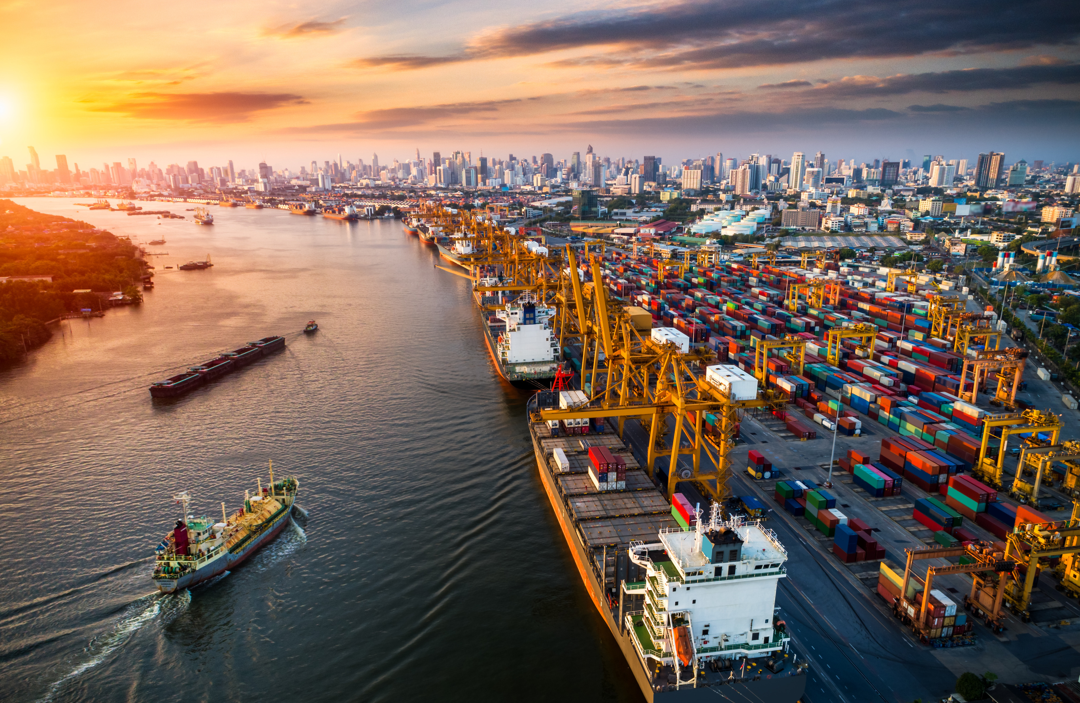


INTEGRITY
SHIPPERS
NAVIGATING
GLOBAL EXPANSION IN THE LOGISTICS INDUSTRY
A BUSINESS PRESENTATION BY
RUPAA SHRI S
NANDITHA KRISHNA KUMAR
THARIQ MOHAMMED Z
ROHITH S V
ANGELIN SARA JACOB

Slide 2






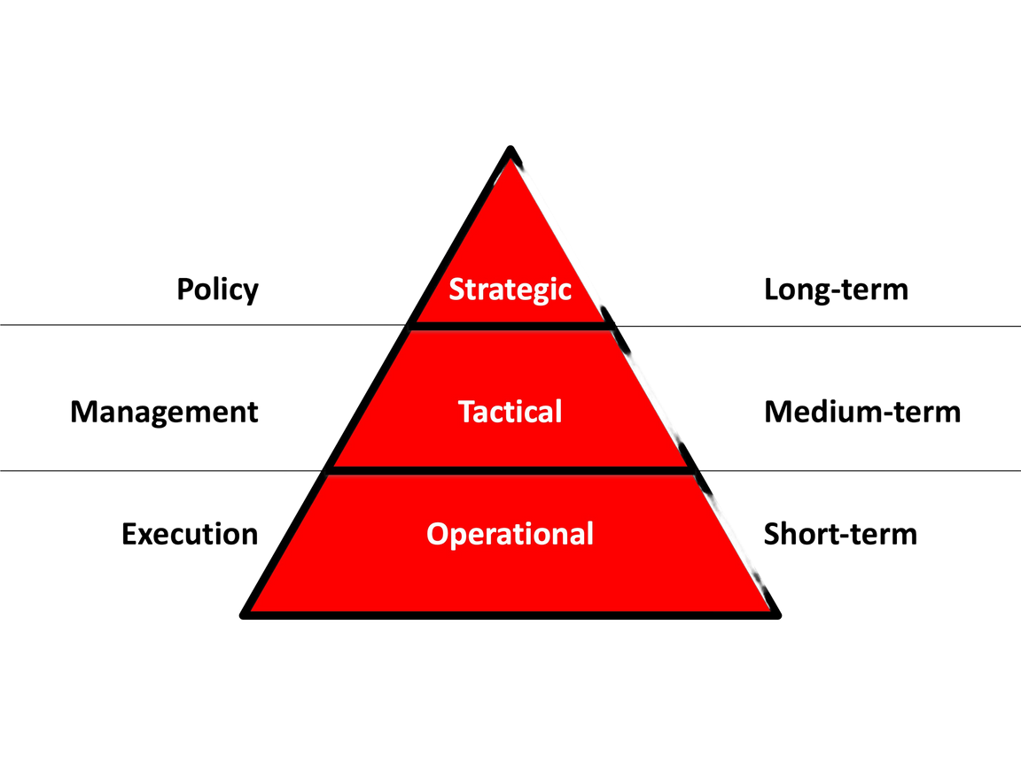




BACKGROUND
STRATEGIC EXPANSION
Freight transportation service company based in Bangalore, India. Operating since 2007 all over India
By 2015, secured a market share of 15% in the Indian freight transportation industry to become top three players in the market.
The company’s reputation for delivering goods on time, has solidified its position as the market leader in India, with a current market share of 30%.
DECISION MAKING
OBJECTIVE
To determine the best possible location to expand to
To estimate the payback period using cash flows
MAJOR FACTORS IN DECISION MAKING
Market
Favourability
Regulatory Conditions
Workforce Availability

Slide 3

METHODOLOGY
FACTORS AFFECTING EXPANSION AND THEIR PROBABILITY AND PAYOFF MATRIX
DECISION TREE TO IDENTIFY WHICH COUNTRY TO EXPAND AMONG THE ALTERNATIVES
USE CRYSTALL BALL SIMULATION TO ESTIMATE THE POSSIBLE PAYBACK PERIOD
ASSUMPTIONS
Constant 14% interest rate across all forecast years.
Constant 30% corporate tax rate across all regions for all forecast years.
15% of the net income generated in India would be the projected net income for Year 1 in whichever region Integrity Shippers chooses to expand.

Slide 4

INSIGHTS AND RECOMMENDATIONS
INTEGRITY SHIPPERS
From the analysis, it is clear that Dubai is the most cost efficient option for expansion.
From the sensitivity analysis, it can be observed that within Dubai, the decision to hire employees locally or from India affects the payoff the most.
70% chance to breakeven within 9 years.
DUBAI

Slide 5

INTEGRITY
SHIPPERS
thank you

